Slide 1


SDP
LECTURE
High Quality Software
Software Design Patterns
Diploma in IT
Year 2 (2024/25), Semester 4
2.1
Notes:
Hi everyone! We know that the purpose of using design patterns is to produce good software, but what does that even mean? What makes a program good? In this lesson, we’ll discuss the aims of using design patterns, and why they can be crucial for modern complex software systems.

Slide 2
Aims of Software Design Patterns
Software Design Patterns are solutions that primarily aim to produce software that is
Buildable – can be implemented without error
Maintainable – can be updated (relatively) easily
Extendible – can add new features without affecting existing features unnecessarily
Reusable – can be ported over to other similar projects
Notes:
Software engineering is a huge discipline that includes everything from coding and design patterns to project management and budgeting. In this module, however, we are focusing on software design patterns, which help to address some of the issues of quality design. Specifically, design patterns help us to produce software that is || buildable, meaning that the system can be constructed without error, because design patterns provide solutions to well-known problems. Not only that, a good design pattern will try to make it so that the code is || maintainable, so that when the inevitable change requests come in from the clients, you are unlikely to have to rewrite substantial parts of the code. Related to maintainability is the concept of || extendibility, which is the adding of new features to the system. Design patterns try to minimize the chances that adding a new feature will require changing any of the existing features unless absolutely necessary. Finally, design patterns try to make parts of the code || reusable to other parts of the system or even other projects by doing lots of good encapsulation and information hiding so that different parts of the system are as independent from other parts as possible.

Slide 3
Cohesion
Cohesion describes how much a component contributes to a single purpose
Ideally, all components should have only one responsibility
If a component has low cohesion
It is more complex
Changes are harder to implement
It is harder to reuse
We want to have high cohesion
Notes:
In order to achieve these aims, it is important to understand two important concepts, called cohesion and coupling. Let’s cover cohesion first.
Cohesion describes how much || a component contributes to a single purpose. The term component refers to any single part of a software system, whether it is a class, method, a library or even a block of code. A single component should not have multiple responsibilities, and || ideally, we want all components in our system to have only one responsibility. The reason is because if a component has low cohesion, meaning that it handles multiple responsibilities, then it is || more complex. The code will be longer, so if we need to change the code, it is harder to find the specific lines of code that need to be changed, and there is a chance that a change may affect other parts of the code within the component. All this makes || changes harder to implement. Also, if a component has multiple responsibilities, it is || harder to reuse that component in other applications since it is less likely that the other application will require all the services provided by the component. For these reasons, || we want to design our systems with high cohesion by putting code that handles separate tasks into separate components as much as possible.

Slide 4
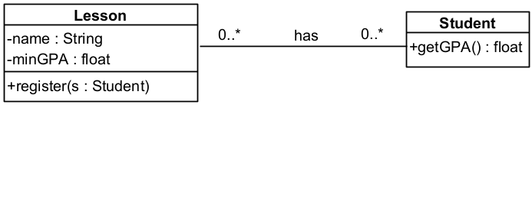
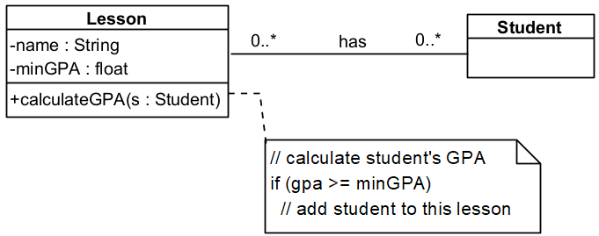
Operation and Class Cohesion
Operation cohesion – does the operation focus on a single task?
Class cohesion – is the class focused on a single responsibility?
Notes:
We can break down the concept of cohesion in OO programming into different categories. For example, || operation cohesion refers to operations or methods, and asks, “does this operation focus on a single task?” We want to avoid operations that do multiple things if we can help it. || Class cohesion refers to classes, and asks, “does this class deal only with a single responsibility?” Where possible, a class should mind its own business and only affect things directly related to itself.
Take || this example. We have a Lesson class that has a minimum GPA pre-requisite, given by the minGPA attribute, such that only students that meet this minimum GPA can take this lesson. We have an association with the Student class that represents the list of students taking this lesson. In addition, the Lesson class has a || calculateGPA() operation that takes a student object as its parameter. This operation first calculates the student’s GPA, and if it is equal or greater than minGPA, the student will be registered to take the lesson.
While this works, it’s a pretty bad design. Notice that the calculateGPA() operation does 2 things – it calculates the student’s GPA and enrols the student to the lesson, which is poor operation cohesion. One issue is that it is not apparent from the name of the method that it registers the student. Also, there is no way to just check the student’s GPA without registering, or to register without checking the GPA. Another design problem is the fact that the code for calculating the Student’s GPA is in an operation in the Lesson class, which is poor class cohesion. The responsibility for calculating the student’s GPA should really be in the Student class so that other classes that use the Student class can have access to it. Instead, || this is a better design. We give the Student class a getGPA() method that returns that student’s GPA, and rename the method in Lesson to be register(). The register() method will call the getGPA() method of the student and then decide whether to register the student or not.

Slide 5
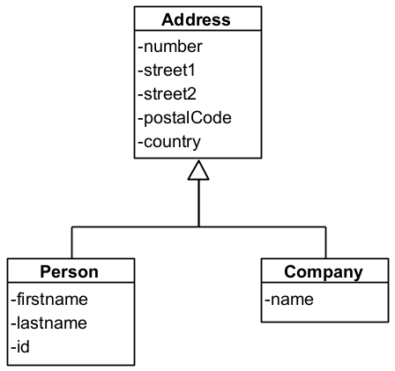
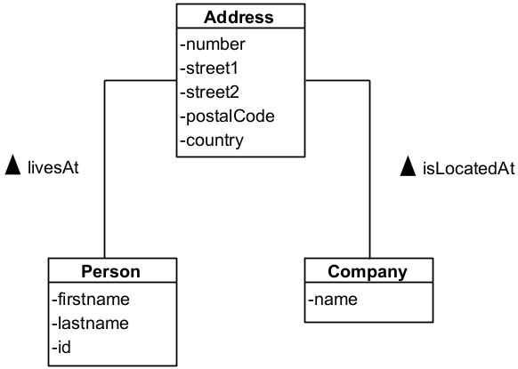
Specialization Cohesion
Specialization cohesion – does the inheritance reflect an “is-a” relationship?
Notes:
In object-oriented programming, we can create base classes and have subclasses inherit from these base classes using specialization. While this is a cool feature, we must be careful to use specialization only when it is appropriate. We call this || specialization cohesion, which asks if the inheritance truly reflects an “is-a” relationship. Let’s take || this example. We have an Address class that contains quite a few attributes. In this system, there are 2 types of addresses – a personal address that includes the first and last names of the person and an ID number, and a company address that only has a name. In this design, it assumes that Person and Company are types of addresses, but is that really the case? The id attribute in the Person class, for example, implies that the Person class represents an actual person, not just a personal address. Instead, a better design would be something like || this, where we use associations instead. So a Person lives at an Address, and a Company is located at an Address, and this makes a lot more sense.

Slide 6
Coupling
Coupling describes the amount of interconnectedness between components
If components have high (or tight) coupling
Changes in one component is likely to affect the other
Implementing a functionality may be more difficult as multiple components may have to be involved
Harder to test the system – issues arising may be due to multiple components
We want to have low (or loose) coupling
Notes:
Now let’s talk about coupling, which || refers to the amount of interconnectedness between two components. This measures how much the workings of one component depends on another. We want to avoid high coupling where possible, because if two components are tightly coupled, changes in || one component will be more likely to affect the other. Also, when you implement a single functionality in a tightly coupled design, || this may involve multiple components, which makes it harder to code. Similarly, || testing becomes more difficult if multiple components are involved since you will have to check that multiple components are correct. Ultimately, we want to have || low (or loose) coupling between components by making each component as independent of others as possible.

Slide 7
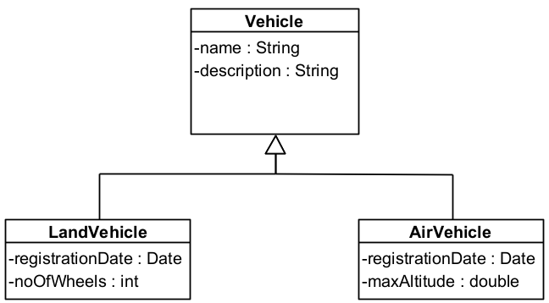
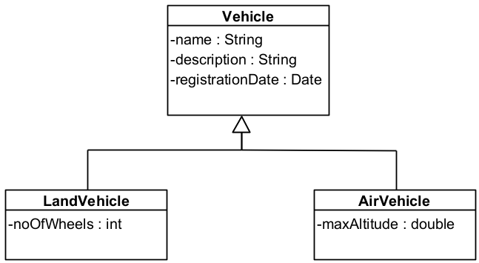
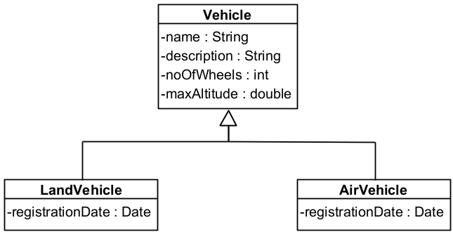
Inheritance Coupling
Inheritance coupling – does a subclass require the features inherited from its superclass?
Notes:
Just like for cohesion, coupling can be broken down into multiple categories. || Inheritance coupling measures whether everything a subclass inherits from a superclass is necessary, because we want to avoid inheriting unnecessary data. Take || this example where we have a Vehicle base class that contains the attributes name, description, noOfWheels and maxAltitude. We also have subclasses LandVehicle and AirVehicle that both have a registrationDate attribute. Immediately we see that the LandVehicle class inherits an unnecessary attribute maxAltitude, because LandVehicles, well, they are on land. We could always set the value of maxAltitude for LandVehicles to zero, but why bother? And if we never care about the number of wheels on an AirVehicle, then the inheritance of the noOfWheels attribute to the AirVehicle class is also unnecessary. To solve that and improve the inheritance coupling of our design, we could || move the attributes from the base class to the subclasses. Since noOfWheels and maxAltitude are relevant only to the LandVehicle and AirVehicle classes respectively, it is better to move those attributes to the respective classes. Another aspect of inheritance coupling is whether we have unnecessarily duplicated attributes. In this design, we see that both || LandVehicle and AirVehicle have the registrationDate attribute. Instead of doing that, if we are sure that all Vehicles in our system will have a registrationDate, then we can || move the registrationDate attribute to the base class so that if we create new subclasses of the Vehicle class, they will automatically inherit the registrationDate attribute.

Slide 8
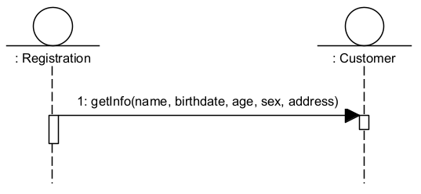
Interaction Coupling
Interaction coupling - how many message types does one object send to another, and how many parameters are there within these messages?
Notes:
Another measure of coupling is known as || interaction coupling, which looks at the number of message types that one object sends to another, and the number of parameters within these messages. An object is said to send a message to another object if it calls a method of that object, so the more different methods that an object calls from another, the higher their interaction coupling. The number of parameters also matters. Take a look at || this sequence diagram, which shows that the Registration object sends a message to the Customer object called getInfo() with 5 parameters. This means that if any of those 5 parameters change, for example if Customer now has a firstname and a lastname instead of just one name, then the calling object will probably have to change as well. In this case, we see that the Registration and Customer objects are quite tightly coupled. This may be unavoidable in some cases, but in general we want looser coupling between components.

Slide 9
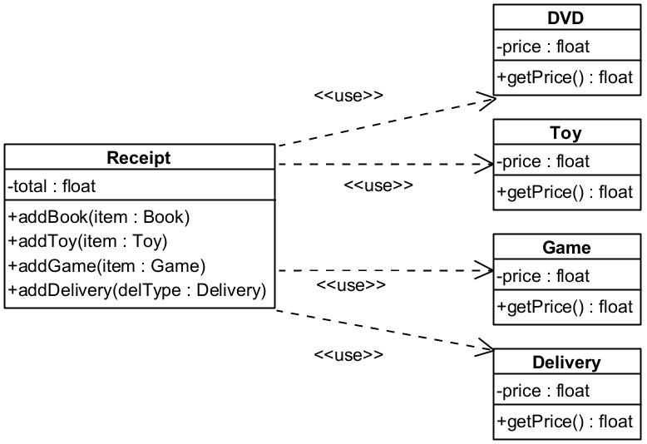
Interaction Coupling
Notes:
Here is another example to illustrate interaction coupling. We have a Receipt class that has 4 different methods that allow it to add 4 different types of object – a Book, a Toy, a Game or a Delivery. This means that the Receipt class needs to know about all 4 of these classes, and we can reflect this explicitly in UML with the || use association. But when you think about it, when you add a Book to the receipt, all you are really doing is adding the price of the Book to the total. So what the Receipt class requires is only the price. Knowing this, is there a better design?

Slide 10
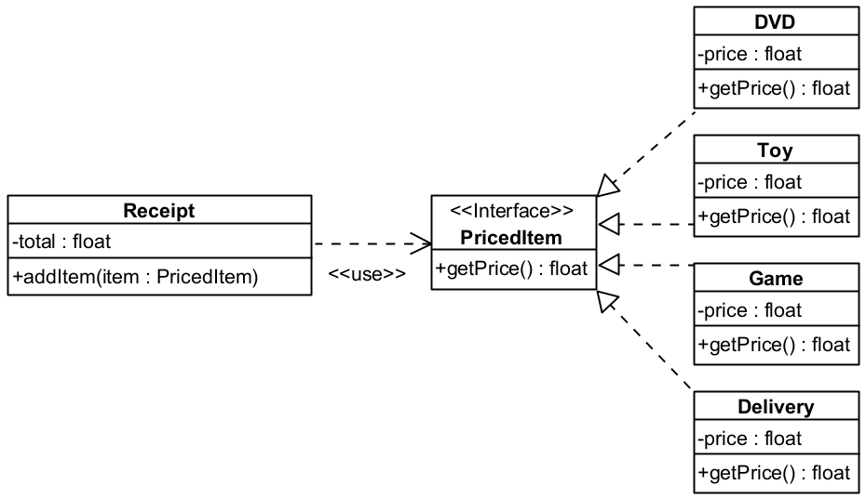
Interaction Coupling
Notes:
Here is an alternative. Instead of having 4 different versions of adding an item to the Receipt, we have only a single method called addItem() that takes as its argument an object of type PricedItem. So what is PricedItem? We could make PricedItem a superclass, and then have all the other classes like Book and Game and so on become subclasses of it, but there is a more elegant solution. Let’s make PricedItem || an interface, so the addItem() method takes in any class that implements the PricedItem interface, which means that they have a concrete implementation of the getPrice() operation. Now we can have our 4 classes || implement the PricedItem interface, and voila, we are done. In this way, if we have a new type of product, say a DVD, we don’t need to create a new addDVD method in the Receipt class. Instead, we just have the DVD class implement the PricedItem interface, and the addItem operation will magically work for DVDs as well. Neat, right?

Slide 11
Summary
Design patterns aim to produce software that is buildable, maintainable, extendible and reusable
We want high cohesion and low coupling
Good cohesion and coupling makes it easier to
Locate where to make changes
Make changes without affecting other components
Logically divide components to allow different teams to work independently
Notes:
Right, so that was a quick overview of what we are trying to achieve with design patterns. We want to produce software that we can build correctly, make changes, add features and reuse for other applications. To do this, in general we want to maximize cohesion and minimize coupling, so that each component handles as few responsibilities as possible, and each component is dependent on other components as little as possible. This means that when we make changes to the code, we can quickly and easily locate where to make the changes, the changes we make are less likely to affect other components, and we can now more easily divide the project up into independent parts that can be worked on separately.
All this sounds good, but of course, it’s trickier than it looks. Lots of software engineers have tried out different designs, and many have failed, but the good solutions have been recorded as design patterns. That’s what this module is all about – teaching you the tricks and techniques that have been discovered by expert software engineers through the ages.

